Slide 1
Git and GitHub
Atul Kahate

Slide 2
What is Git?
A version control system
Why do we need version control?
Imagine that there are two developers who are developing code on an application server

Slide 3
Different Developers Working on the Same Code on their Local Copies
Developer 1
…
…
…
Developer 2
…
…
…
Whose code should be considered as final?

Slide 4
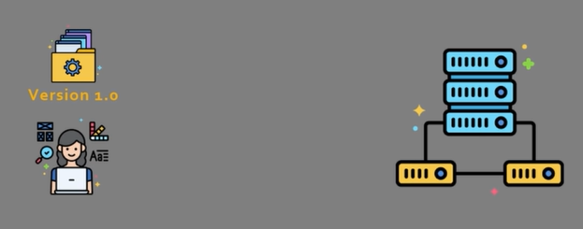
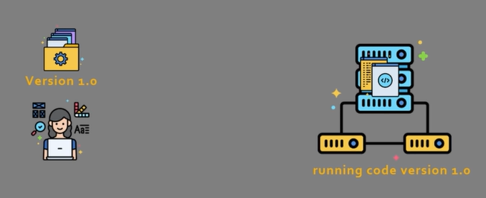
Version control example
Developer 1 wants to push version 1.0 of the code to an application server
After the push, the server runs code version 1.0

Slide 5
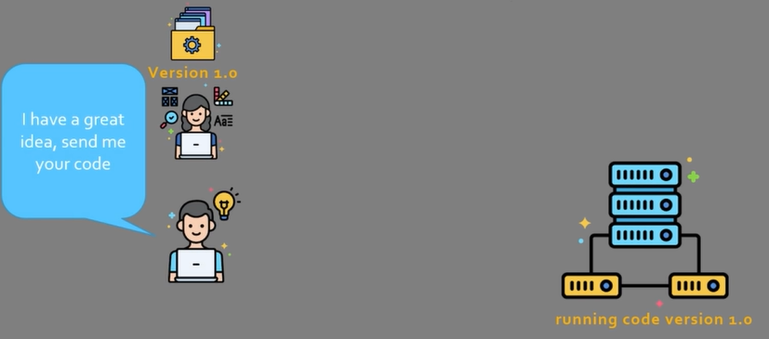
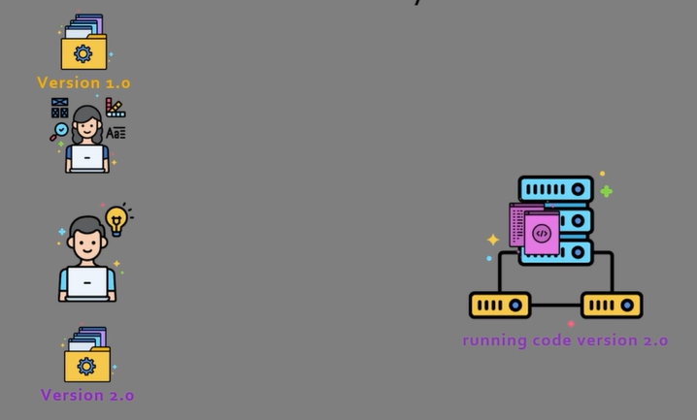
Version control example
Now a team member asks for her code
This team member has a folder called Version 2.0 and has deployed this version of the code on the server

Slide 6
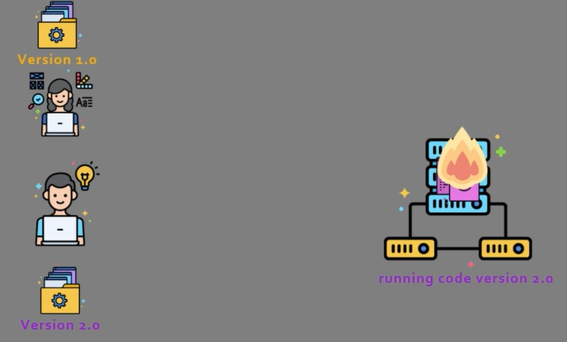
Version control example
Unfortunately, his code was not properly tested, and hence, crashes
Rolling back to version 1.0 is not easy – it is all mixed up

Slide 7
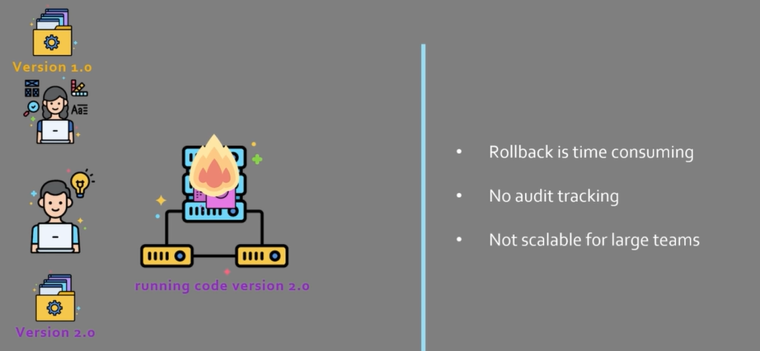
Problem summary

Slide 8
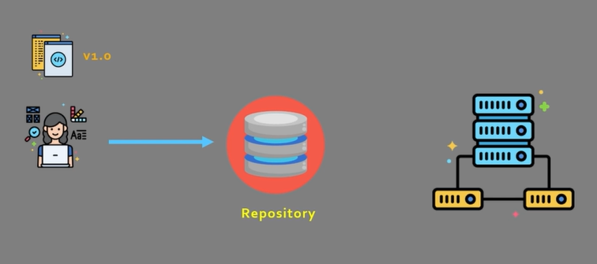
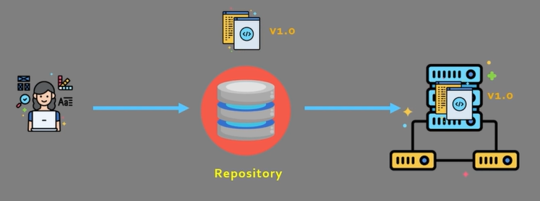
Version Control System and Repository
Developers now push the code to a repository
Code will be deployed from the repository

Slide 9
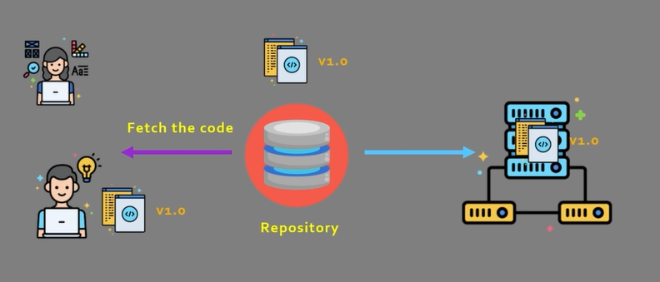
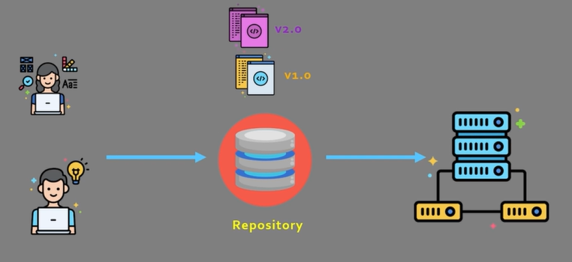
If another team member wants the code …
Fetch
Modify and push

Slide 10
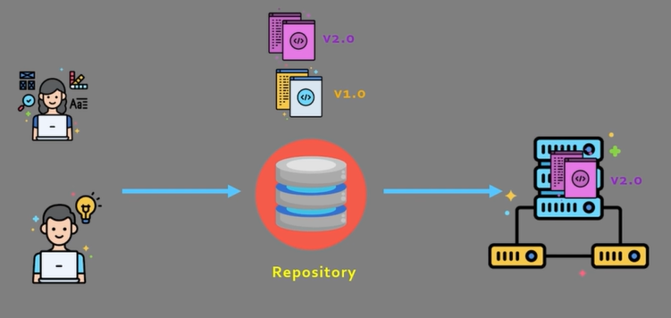
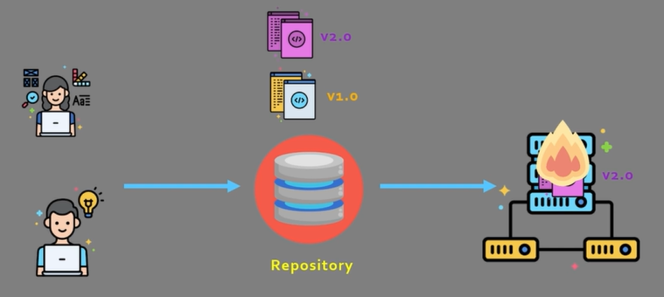
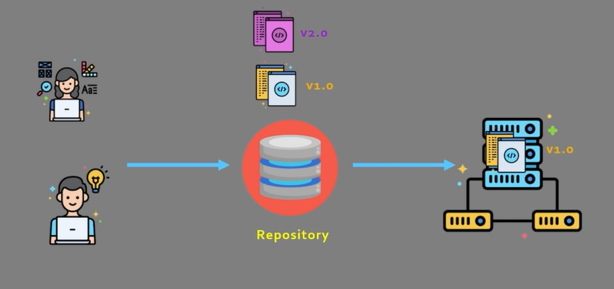
Deploy the new version
Deployed
Problems? Go back to version 1

Slide 11
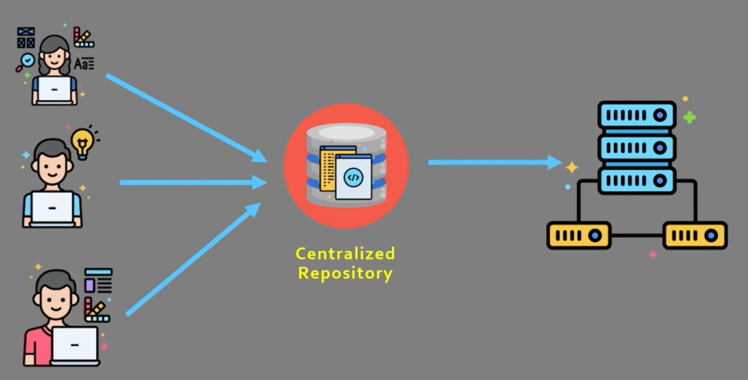
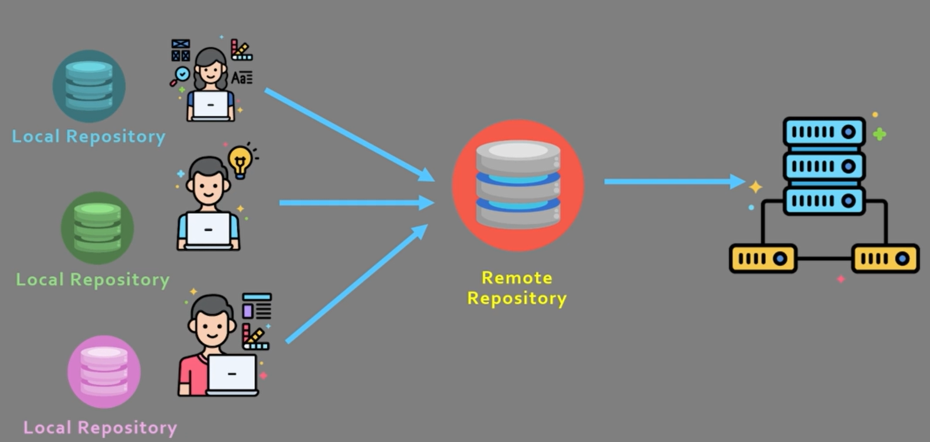
Types of Version Control System
Centralized
Single point of failure
Requires constant connectivity
e.g. Subversion, Endevor
Distributed
Distributed
Each developer has a copy, so loss of connection is manageable
More scalable
e.g. Mercurial, Git

Slide 12
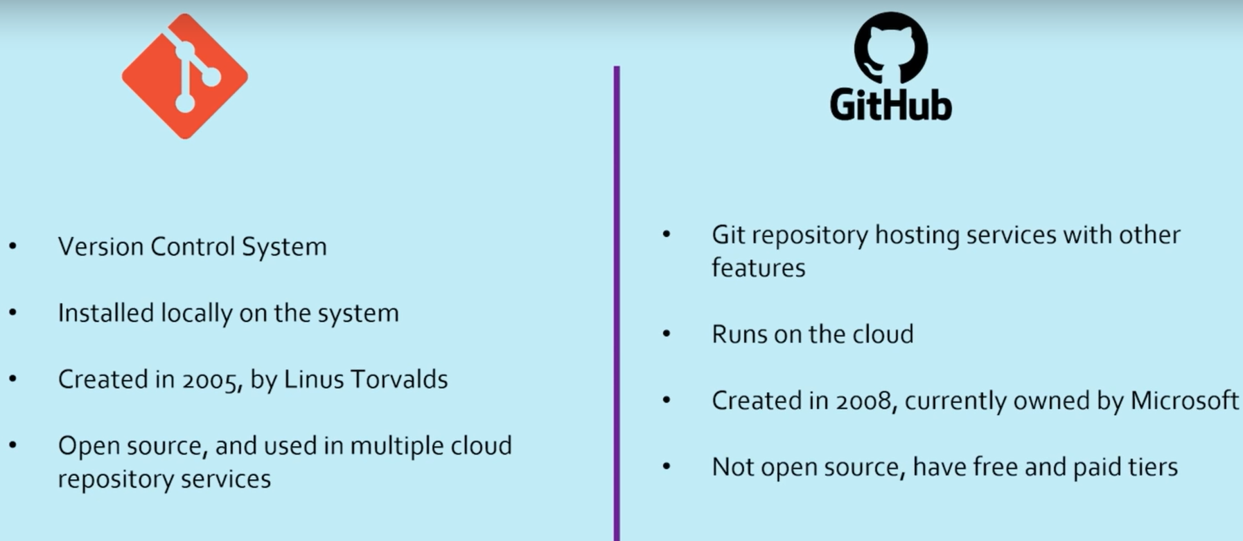
Git is not GitHub

Slide 13
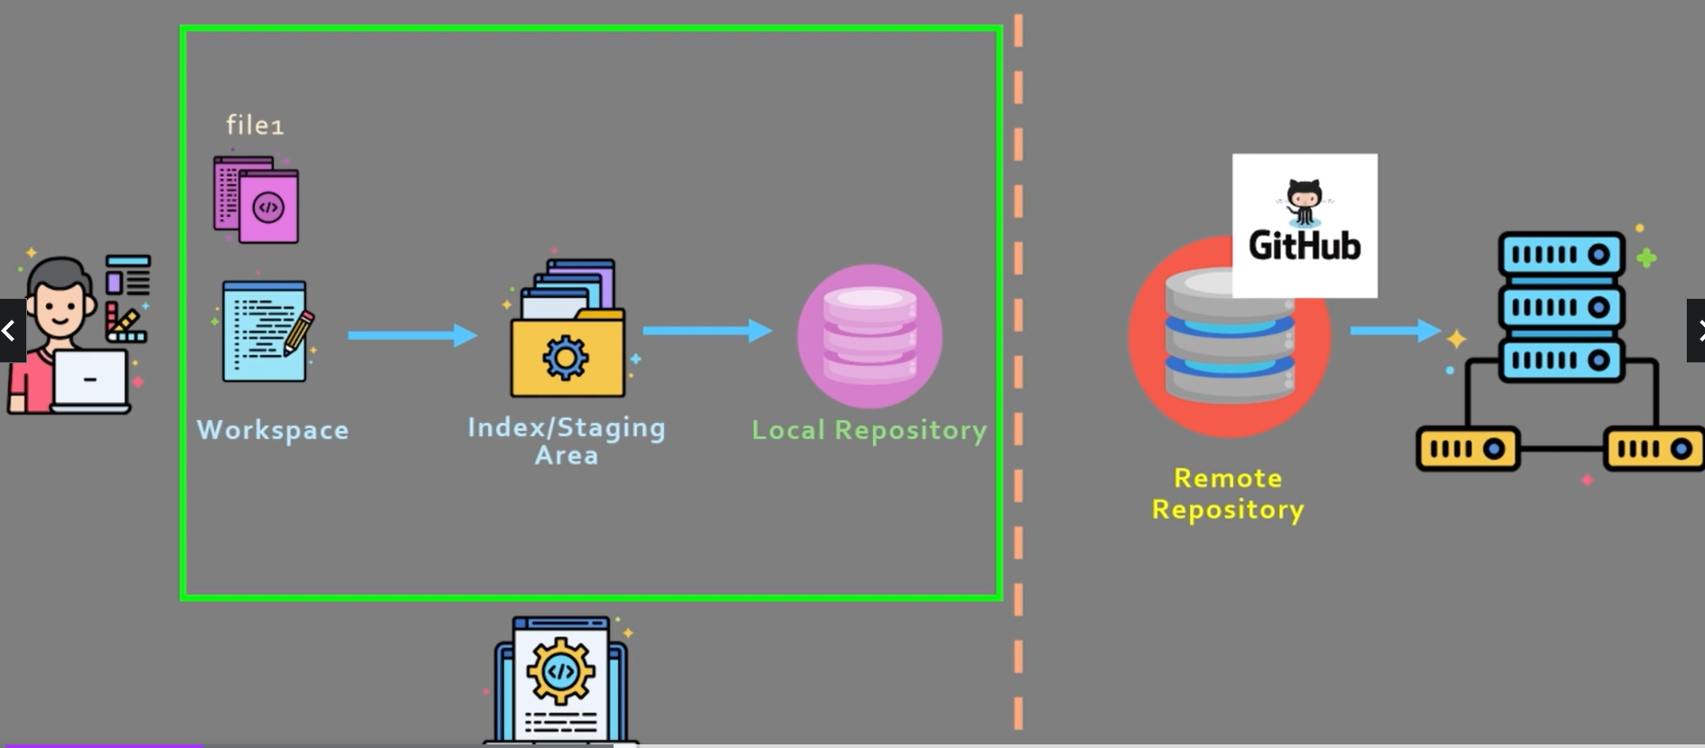
Git Workflow – 1

Slide 14
Git Workflow – 2
There are 3 distinct parts
Workspace – Area where the user is working and creating/modifying code
Index/Staging area – Area that closely mimics the local repository
Local repository – The local area for all the code
How this works? – Next slide

Slide 15
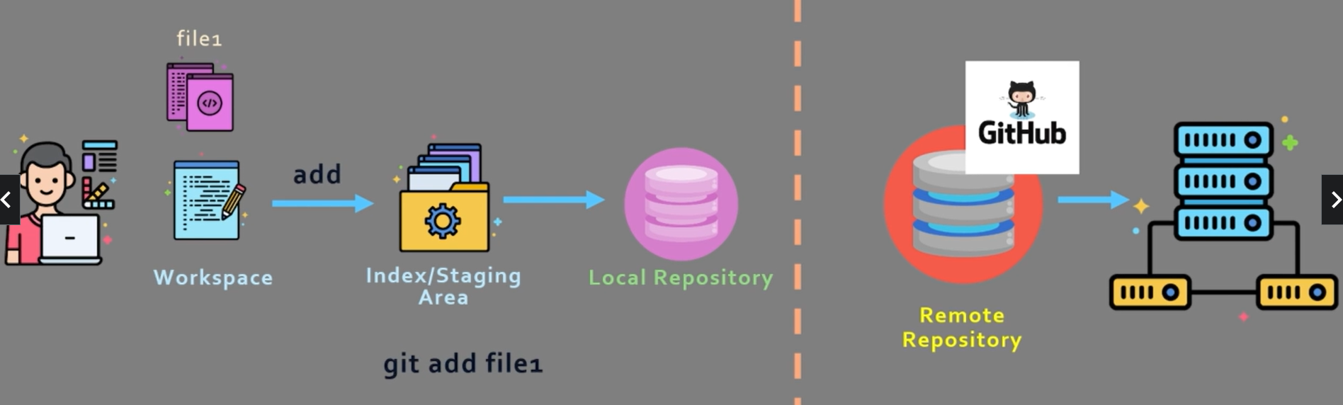
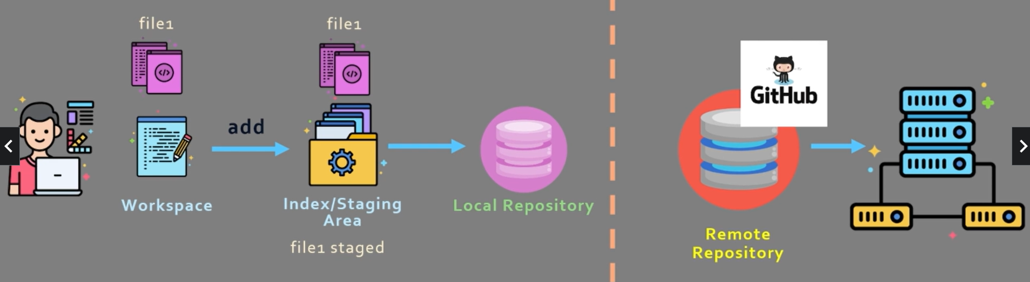
Git Workflow – 3
When user says git add file1, it will get added to the staging area

Slide 16
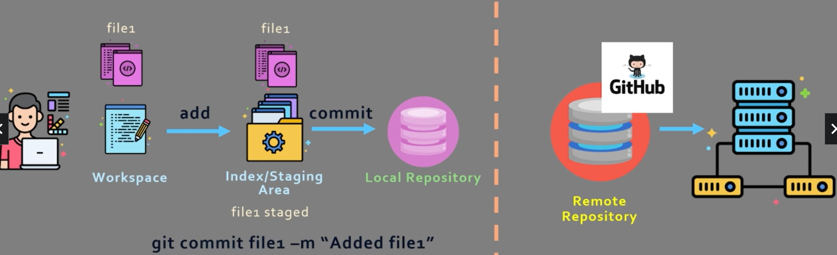
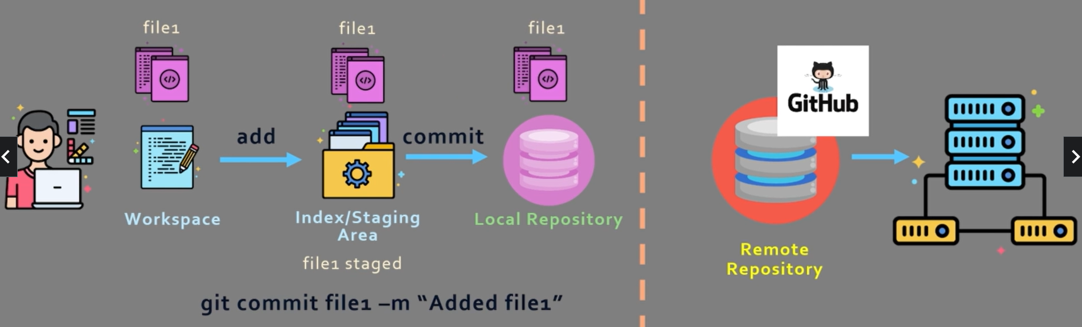
Git Workflow – 4
When user says git commit file1 –m “Added file1”, it will get added to the local repository

Slide 17
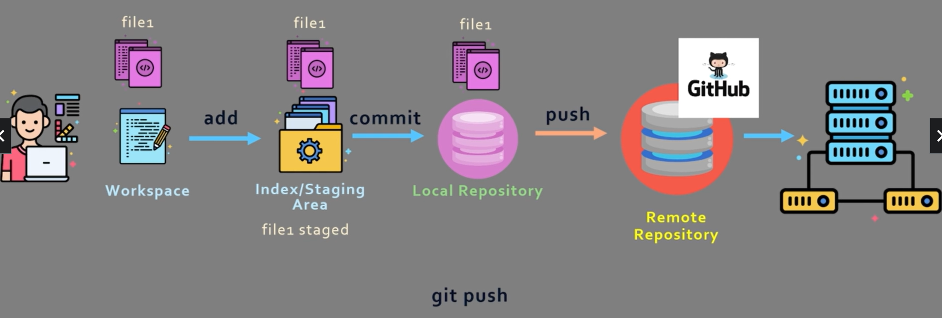
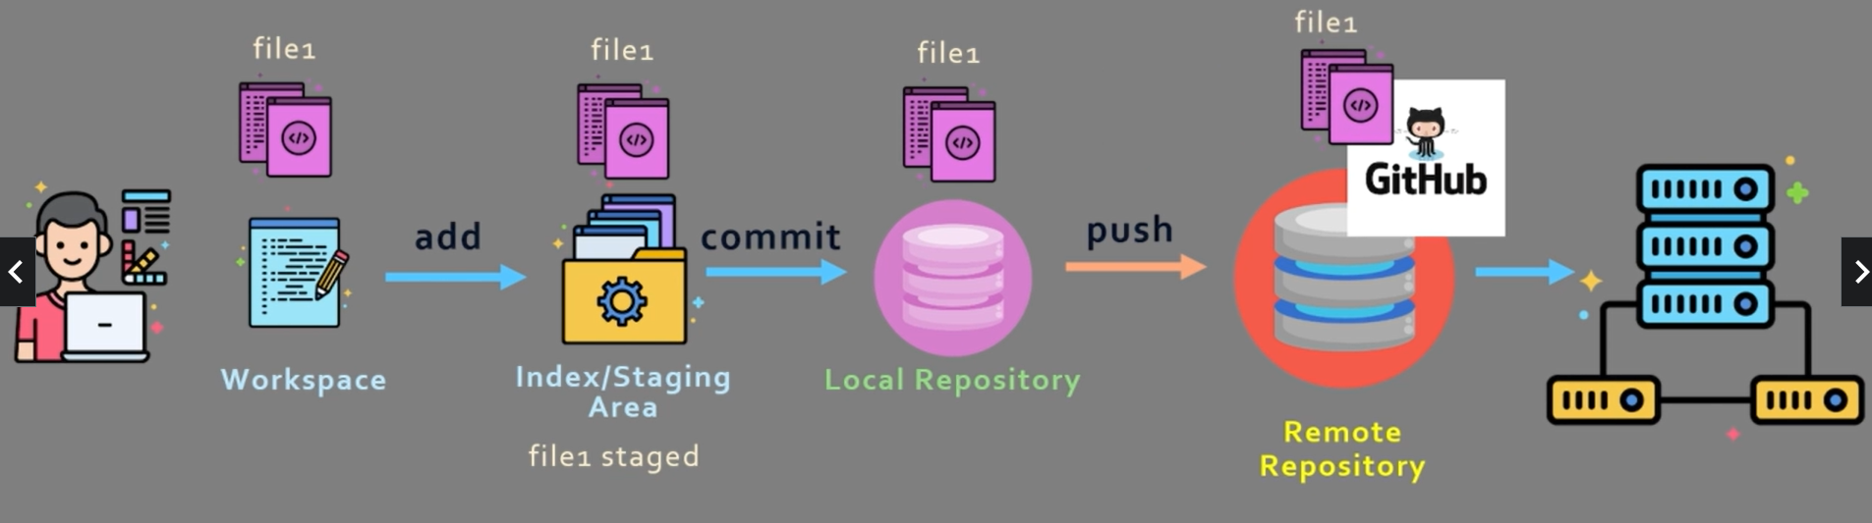
Git Workflow – 5
When user says git push, the changes will go to the remote repository

Slide 18
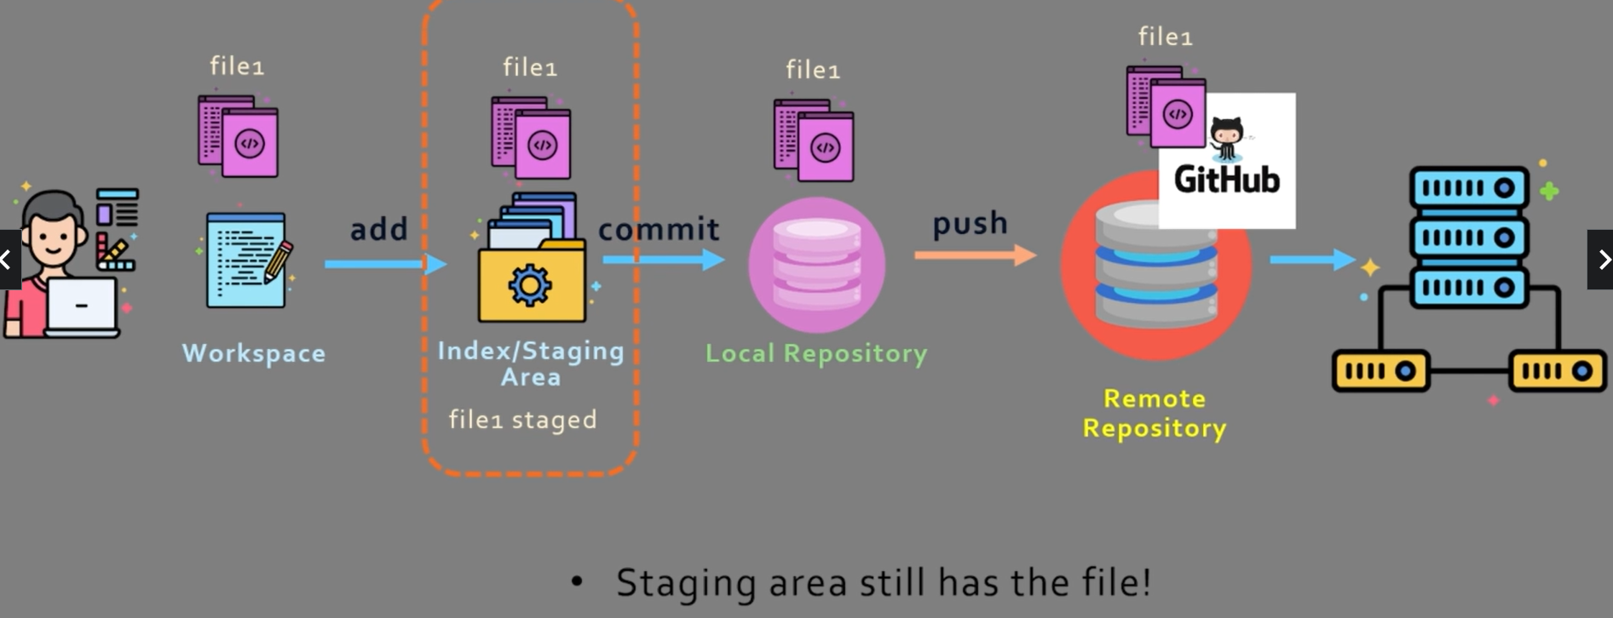
Git Workflow – 6
Important point

Slide 19
Git Setup

Slide 20
Download and Setup
Download git and install
git config --global user.name “Atul Kahate”
git config --global user.email test@test.com
Visit github.com and signup using the above email id

Slide 21
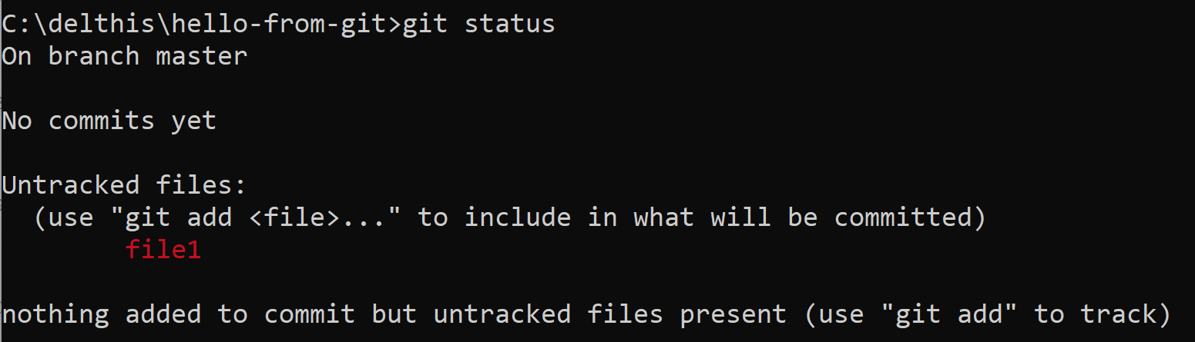
Using git
Create a directory hello-from-git somewhere on the local drive
To enable tracking of this folder by git, in the folder, run git init
Create file1 in this folder in some text editor (e.g. C:\delthis\hello-from-git\file1)
Type Hello World from Git in the file and save it
On the command prompt, type git status

Slide 22
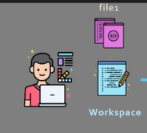
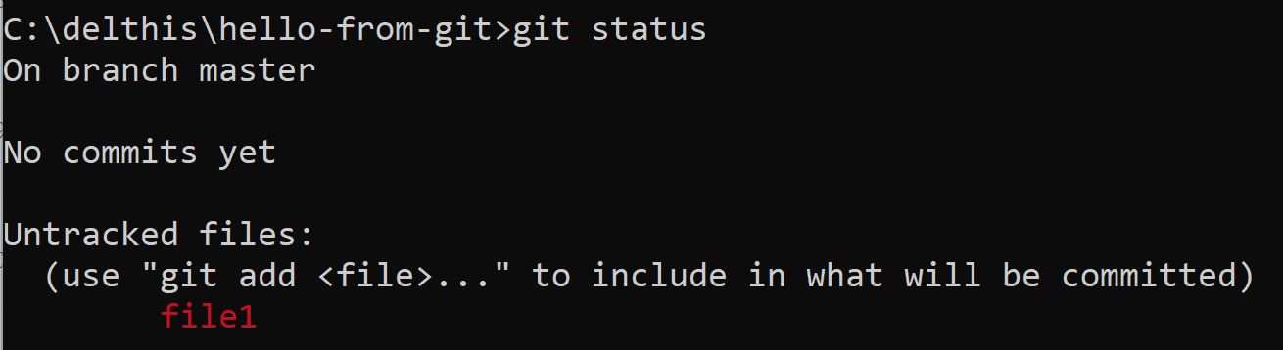
Using git
What does this mean? It means that file1 is in the Workspace

Slide 23
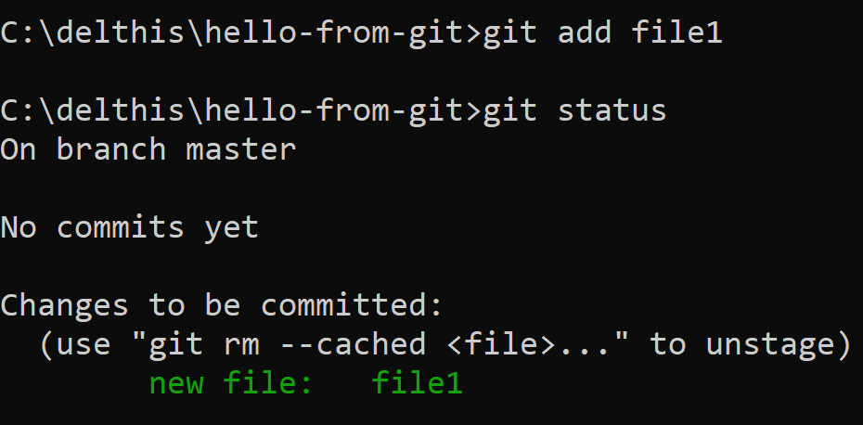
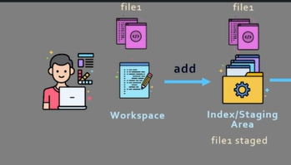
Adding the file to the Index/Staging Area
git add file1

Slide 24
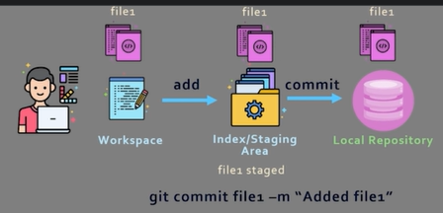
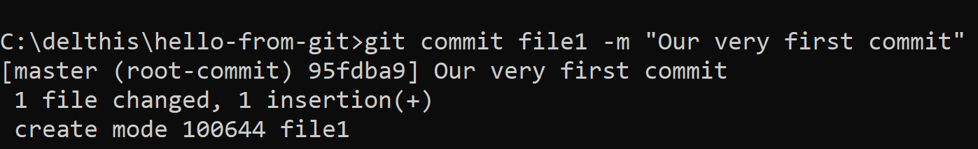
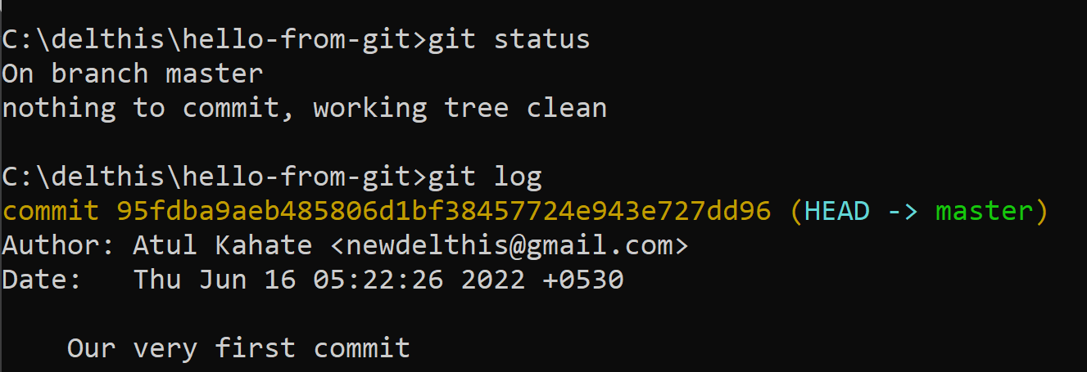
Committing the file to the Local Repository
git commit file1 –m “Our very first commit”
git status and git log

Slide 25
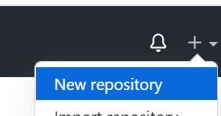

Pushing the file to Github – 1
Go to github and click on New repository
Leave the other defaults and Create repository
Copy the last three commands shown on the next page:
git branch -M main
git remote add origin https://github.com/newdelthis/hello-from-git.git
git push -u origin main

Slide 26
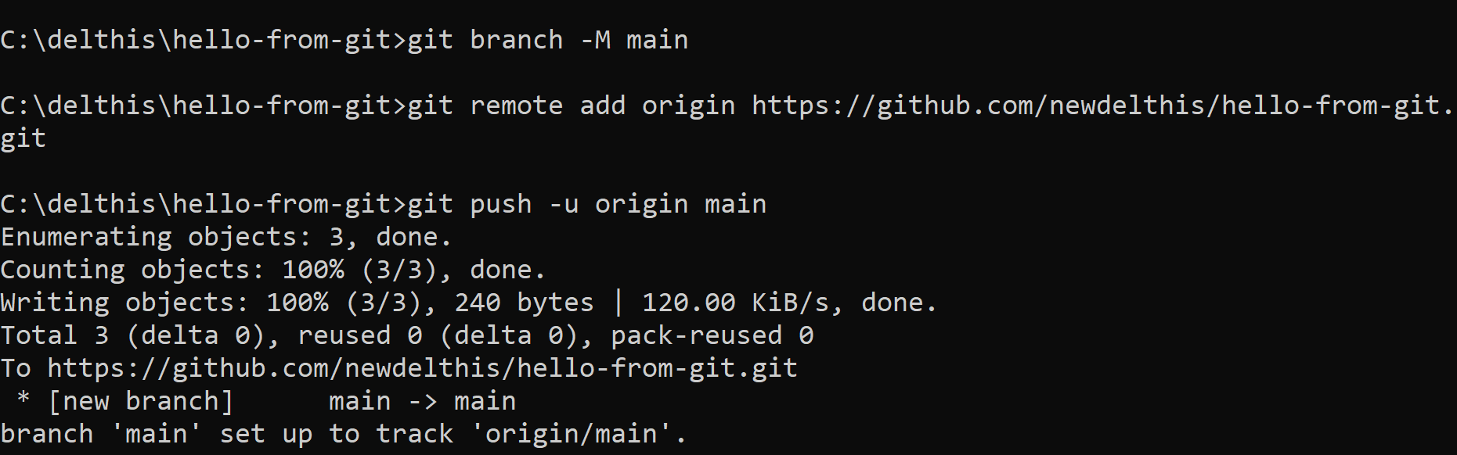
Pushing the file to Github – 2
Paste the three commands on the command prompt and press enter

Slide 27
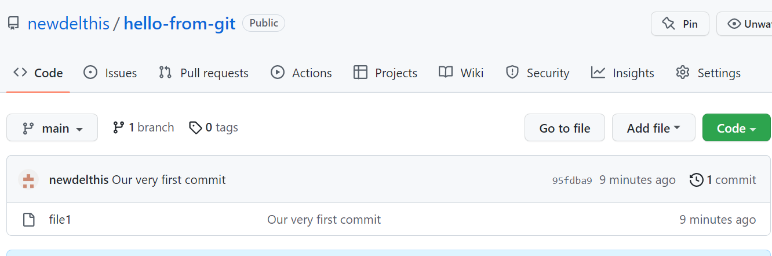
Pushing the file to Github – 3
Verify the repository on the github page by refreshing it

Slide 28
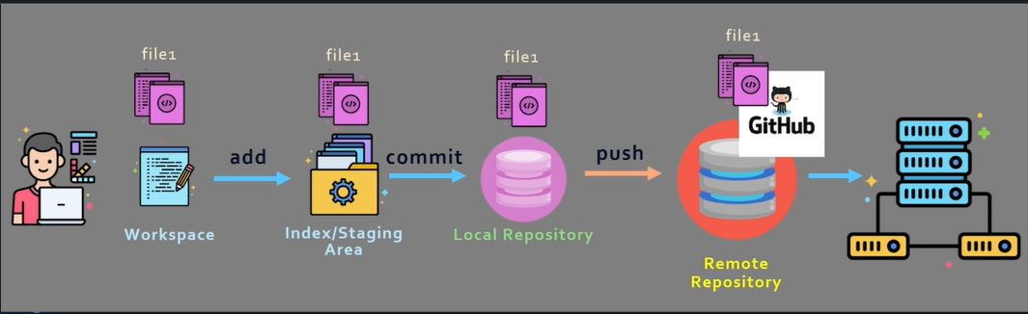
Pushing the file to Github – 4
End result

Slide 29
Comparing files – 1
Let us edit the file in an editor to have these contents (changes in bold):
Hello World, from Git
That was a quick demo
Hope you enjoyed it
Let us see the difference between the local file and file in the staging area by running git diff
See next slide

Slide 30
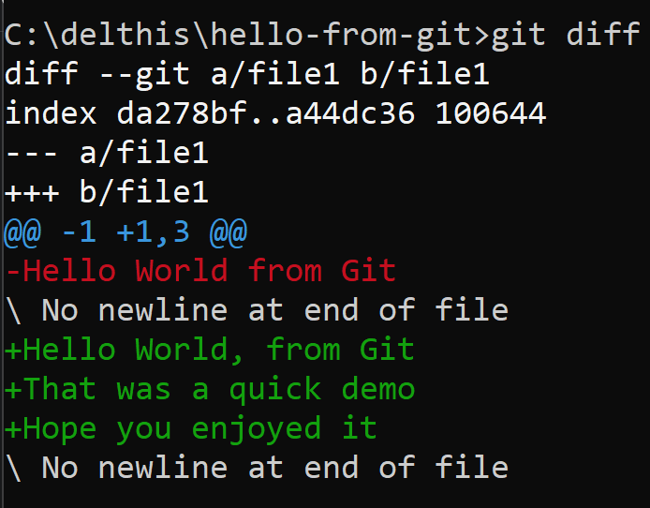
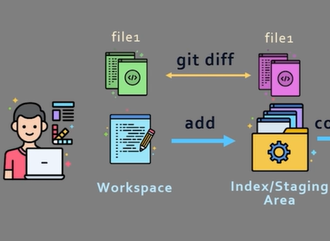
Comparing files – 2

Slide 31
Comparing files – 3: Understanding the results
diff --git a/file1 b/file1
Says that it is comparing the file in two different places
index da278bf..a44dc36 100644
Metadata and indexes
--- a/file1
+++ b/file1
The new and old file, respectively
@@ -1 +1,3 @@
In the old file, changes started from line 1 and ended at line 1
In the new file, changes started at line 1 and ended at line 3

Slide 32
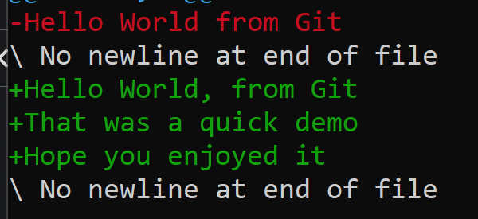
Comparing files – 3: Understanding the results
Deleted lines in red, added lines in green

Slide 33
Again diff, but with a difference
git add .
git diff
Differences between our workspace and staging area

Slide 34
Git Branch and Merge

Slide 35
Branching and Merging – High-level Concept

Slide 36
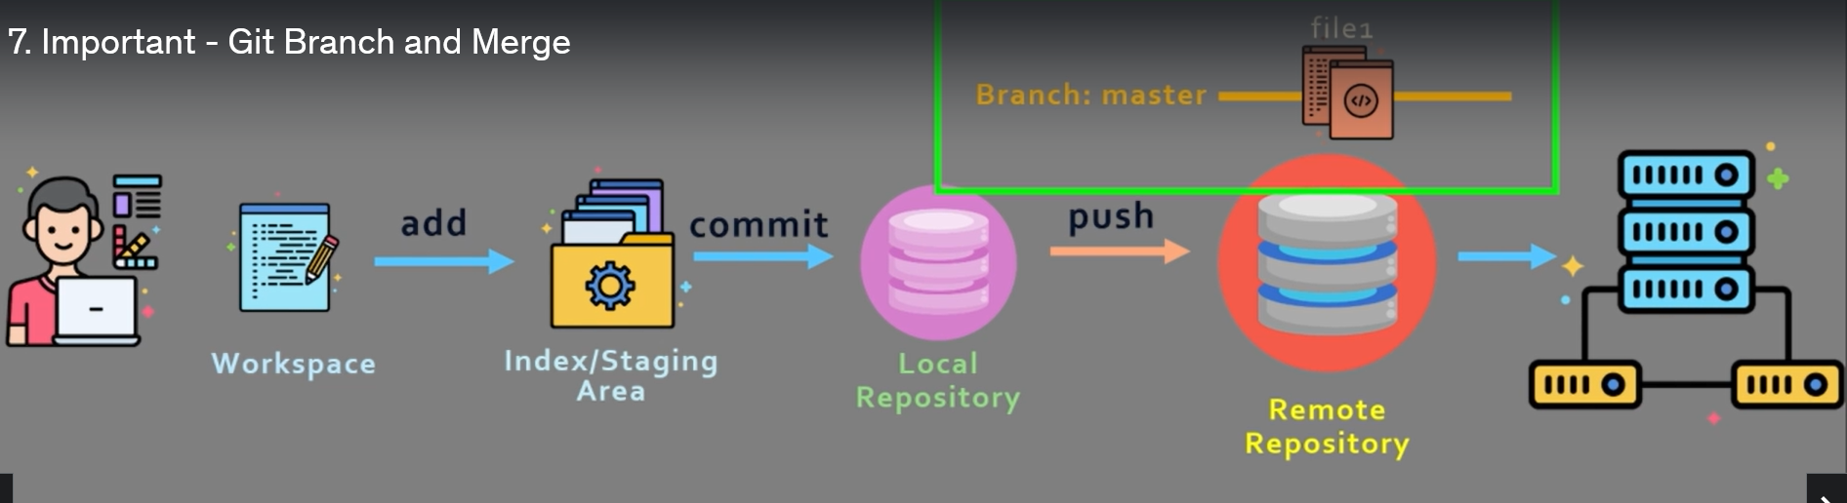
Default Branch
When we push changes to Github, it automatically creates a first branch called as Master

Slide 37
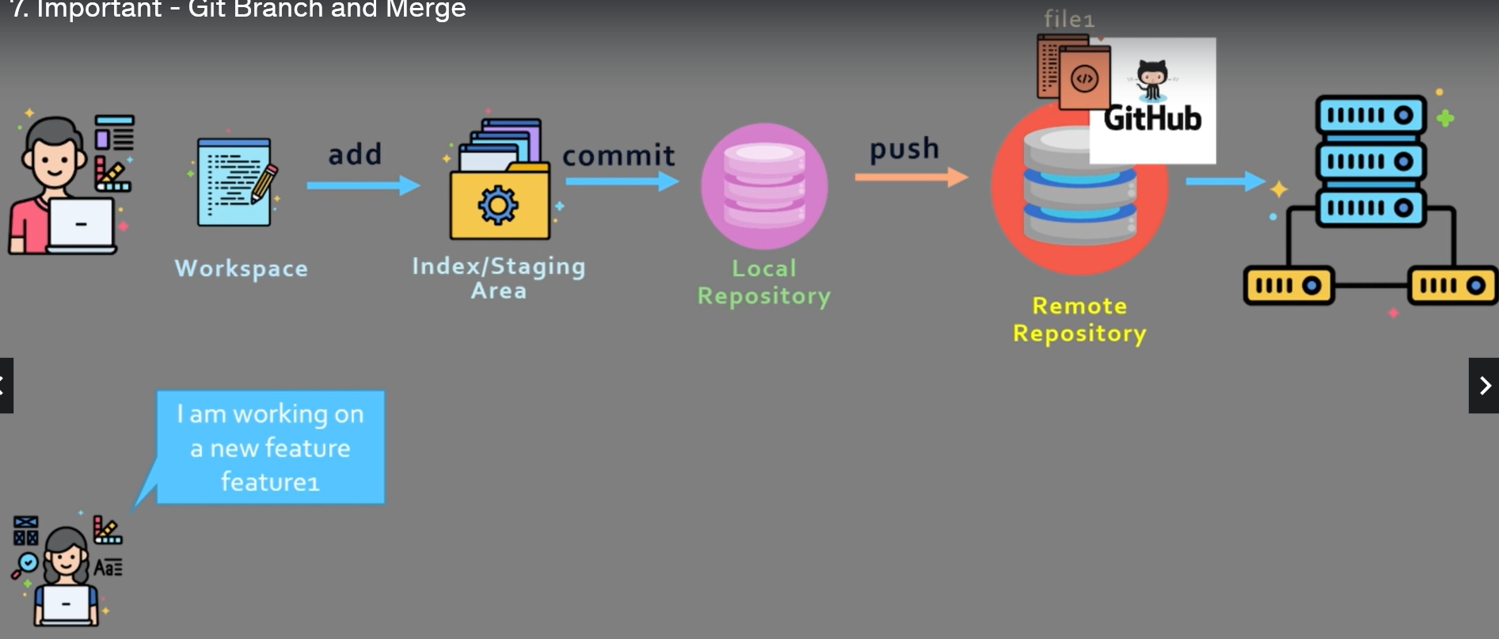
Need for Branch and Merge
Suppose a new developer wants code to add a feature

Slide 38
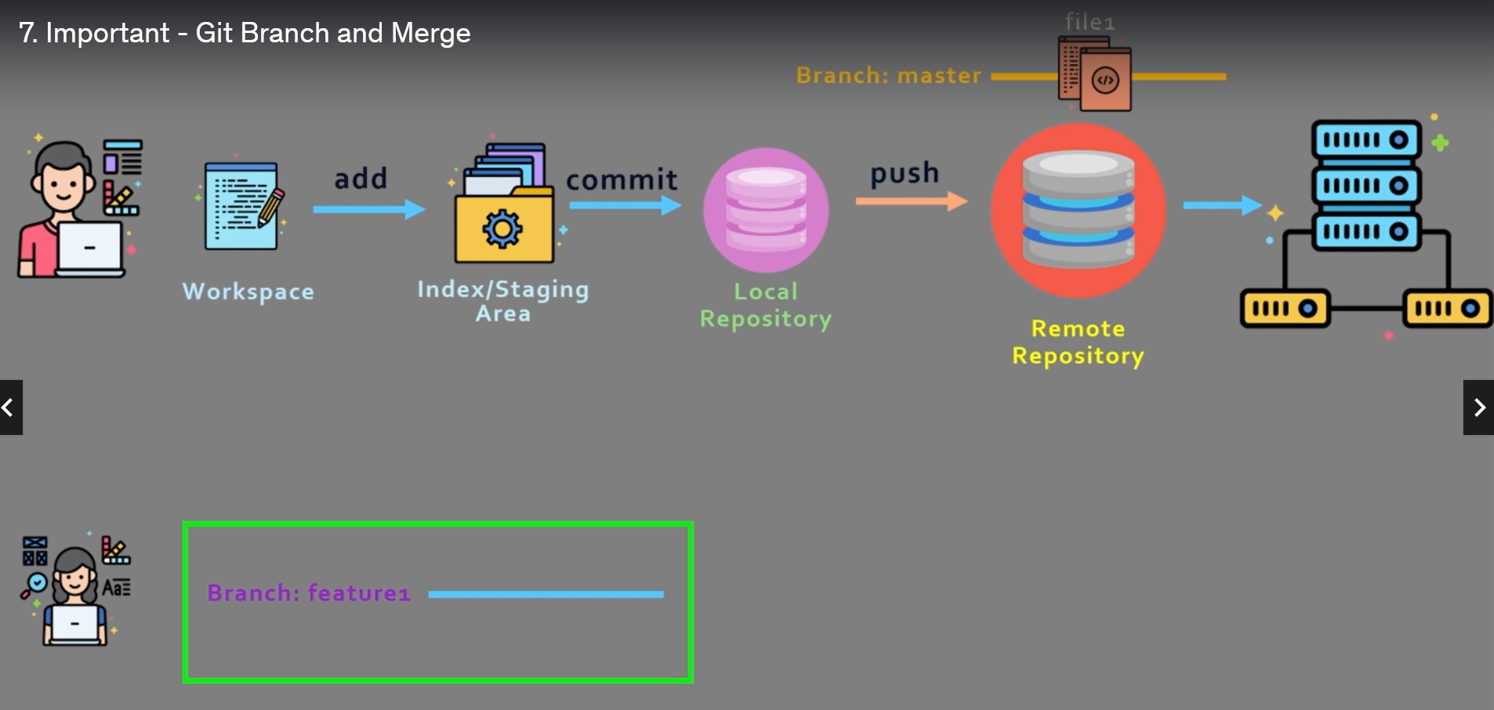
Creating Additional Branches
This developer can create an additional branch for her feature, say called feature1

Slide 39
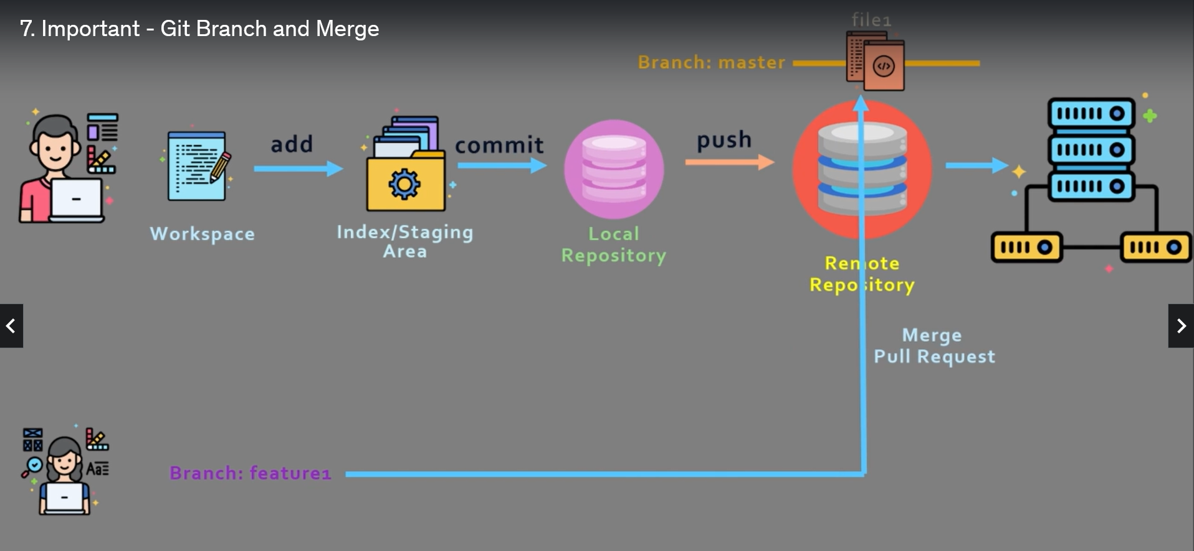
After the Developer completes her work
Someone can review her changes and merge her branch into the master branch

Slide 40
Branching and Merging Step by step

Slide 41
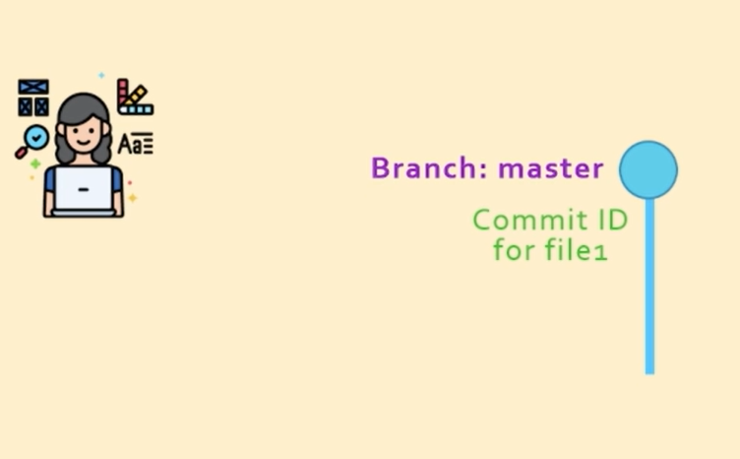
Branching step-by-step
When we create a file locally and commit it, Git automatically creates a branch called Master

Slide 42
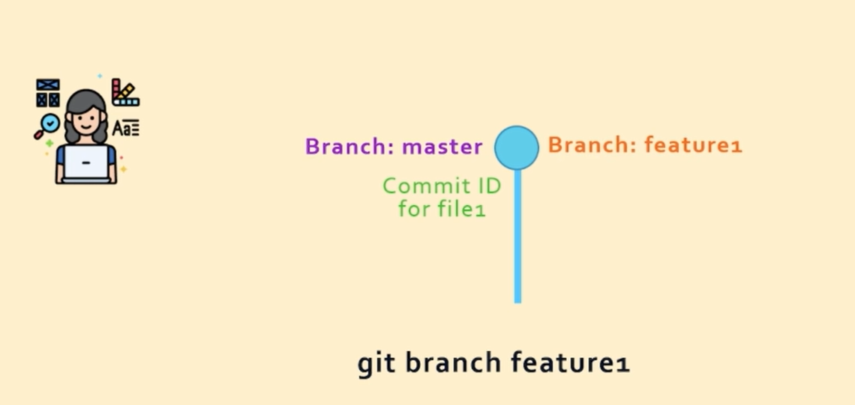
Creating a Branch
To create a branch, we can run a command git branch branch-name, e.g. git branch feature1

Slide 43
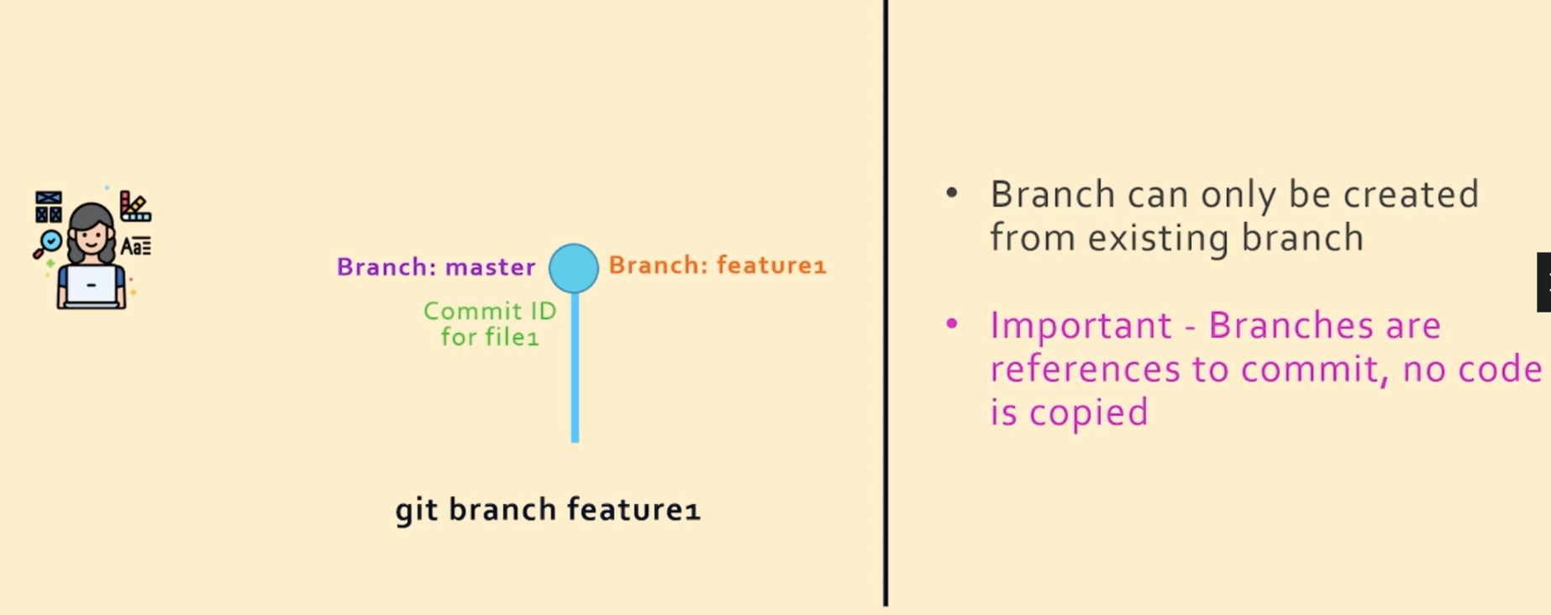
Branching: Key Points

Slide 44
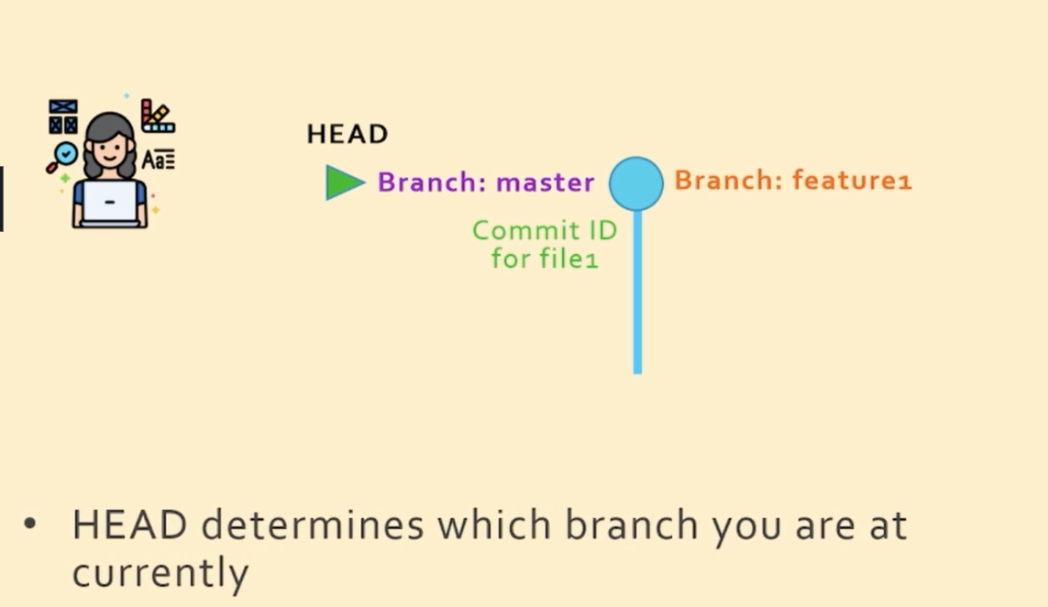
Knowing which Branch we are in
The HEAD pointer

Slide 45
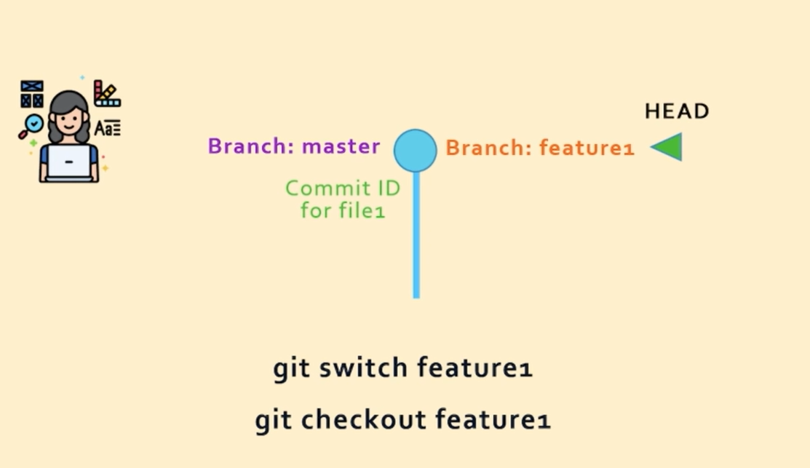
Switching from One Branch to Another
The switch and checkout commands

Slide 46
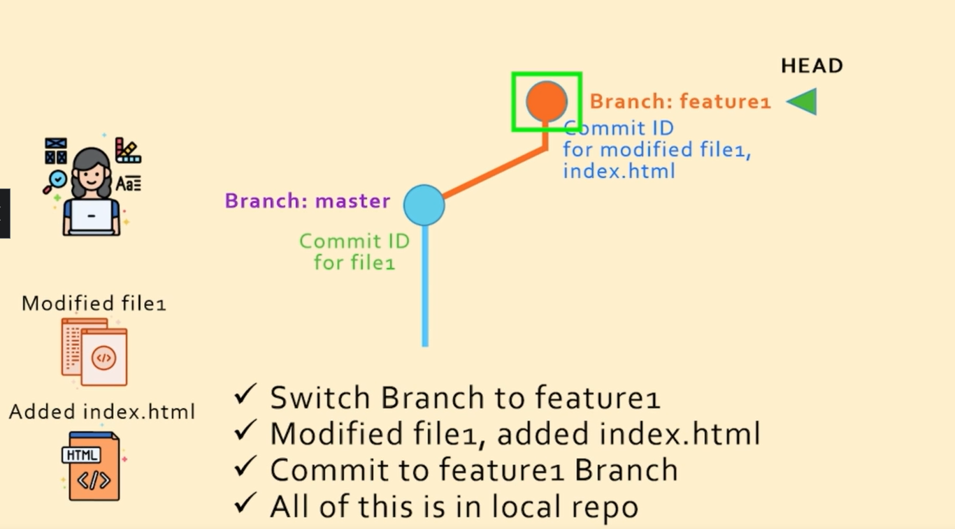
Result of working with feature1 Branch

Slide 47
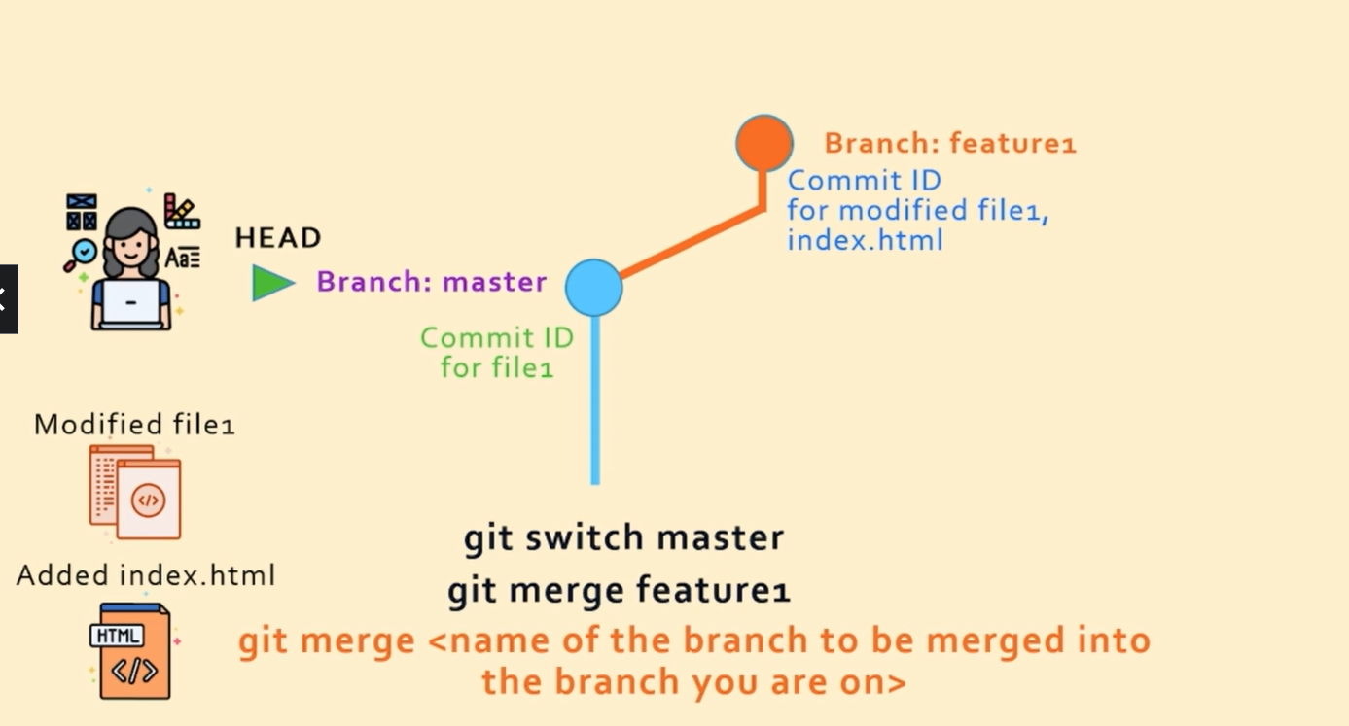
Merging the Changes and Contents of feature1 Branch into Master Branch

Slide 48

Result of the previous command

Slide 49

Result of the previous command
Note: This was possible because no changes were made to the master branch

Slide 50

What if we had made changes to the Master branch also? – Confusion!

Slide 51

Recursive Three-way Merge (Two blue, one orange in the figure)

Slide 52

Important!
We need not tell Git to do a fast forward/recursive three way merge – Git automatically does it. Now we can delete branch feature1

Slide 53
Git Branch Demo

Slide 54


Create hello.py (C:\delthis\git-branch-demo-1)

Slide 55

Check the branch
git add helloworld.py
git commit helloworld.py –m “First commit”
git branch

Slide 56


Check the logs
git log --oneline
Current status

Slide 57


Creating a new Branch
Create a new branch feature1: git branch feature1
Check: git branch
Result

Slide 58

Switch the branch to feature1
git switch feature1

Slide 59
Create testpython.text and then add and commit
Change C:\delthis\git-branch-demo-1\helloworld.py:
print ("Hello, world!")
print ("Added this")
C:\delthis\git-branch-demo-1\testpython.txt: this file has some test data to test our code
Let us add and commit these two files (helloworld.py and testpython.txt) in the branch feature1

Slide 60

Committing the files to branch feature1

Slide 61


What is the status? feature1 branch has moved one step ahead of master
git log --oneline

Slide 62

What if we create another branch, say feature2? See next screen
The new branch feature2 will be at the same level of branch feature1
git branch feature2
git log --online

Slide 63

Current status

Slide 64

Let us merge changes of branch1 into master
git switch master
git merge feature1

Slide 65


Updated status
git log --oneline

Slide 66
Rebasing

Slide 67

Regular Merge
Consider that we have two branches master and feature1

Slide 68

Regular Merge
Committing changes from feature1 to master, we use git merge

Slide 69

Regular Merge
Committing changes from feature1 to master, we use git merge

Slide 70

Regular Merge – Problems
If a lot of people are checking in code, this will make the commit history look very messy

Slide 71
Regular Merge – Problems
If a lot of people are checking in code, this will make the commit history look very messy

Slide 72


Solution – Rebase
Instead of creating a new commit id with every merge, simply move the commits at the end of the master branch

Slide 73

Why Rebase?

Slide 74

Rebase Disadvantages
The commit ids from feature1 are not simply moving over the master branch – git creates copies of them, so the original commit ids for feature1 are gone forever

Slide 75


Rebase Demo
C:\delthis>git clone https://github.com/saha-rajdeep/rebase-demo.git
cd rebase-demo and git branch

Slide 76


Rebase Demo
git log --oneline
git branch feature1

Slide 77



Rebase Demo
git switch feature1
type file1
git add .
git commit -m "added line5 from feature1"

Slide 78

Rebasing feature1 branch on top of the main branch
Now switch to main branch
git switch main
Create file3 in the directory C:\delthis\rebase-demo containing a line this is a test
Add this file to the main branch and commit:
git add .
git commit -m "added file3 from main branch"

Slide 79



Rebasing feature1 branch on top of the main branch
git switch feature1
git rebase main

Slide 80


Still need to bring changes from feature1 into main branch
git log --oneline
git switch main
git rebase feature1

Slide 81



Verification
git log --oneline

Slide 82

Squash Merge
Consider that we have a main branch and a feature1 branch (which contains 3 commits)
We can move feature1 branch to the main branch using merge/rebase command

Slide 83



Squash Merge
But what if all the three commits are related to a single change?
Can we merge all the three commits into one?
Squash merge can do that, but only as a part of rebase

Slide 84

Squash Merge Demo
Create a directory squashdemo under c:\delthis
Create a file named file1 in this containing This is in the 'main' branch.
On the command prompt: git init
git branch main
git switch main
git add .
git commit -m “Committed main”

Slide 85

Squash Merge Demo
Now create another file named file2 containing This is in the feature1 branch. and commit in feature1 branch
git branch feature1
git switch feature1
git add .
git commit -m "Commited feature1“
Keep adding something to file2 and repeat add and commit commands above 2-3 times

Slide 86

Squash Merge Demo
git log --oneline

Slide 87


Squash Merge Demo
git rebase -i HEAD~3
It will open a file git-rebase-todo in an editor
Change pick to squash
for the second and third
Save and close the file. It will open another file for comments. Just close it. Result on the next screen.

Slide 88


Squash Merge Demo

Slide 89

Squash Merge Demo
To see all the comments for the commits: git log (But exiting could be a problem!)

Slide 90
Git stash – 1
Stash holds changes saved in a file but not added to Git.
Create a new directory stashdemo in delthis and create three branches feature1, feature2, and feature3.
Remember that you would first need to create at least one file, add it and commit, so that git creates the master branch. Only then you can create other branches.
C:\delthis>mkdir stashdemo
C:\delthis>cd stashdemo
C:\delthis\stashdemo>git init

Slide 91


Git stash – 2
Now create a file file1 containing some text and save it. Then add and commit it. This will create the master branch.
C:\delthis\stashdemo>git add .
C:\delthis\stashdemo>git commit -m "first commit“
Now create the three branches

Slide 92

Git stash
Now edit file1 to add one more line and save it:
This is a test.
This is another test.
Change the branch
C:\delthis\stashdemo>git switch feature3
C:\delthis\stashdemo>git stash save -m "working on file1"

Slide 93
Git stash
Open file1 in the editor. It will contain only the original one line, since the second one is stashed.

Slide 94



Git stash
Now the switch will work
without messages
git stash list
git stash apply 0

Slide 95

Git stash – Verify
Open file1 in the editor: It should have both the lines.
git stash clear
git stash list

